Slide 1
FlopHouse
A Witspark Product

Slide 2

Introduction
Warden Office

Slide 3
Overview
A Hostel Management System
Features:
Online Applications
Out Pass Allotment
Complaints
Notices
Hostel Information

Slide 4
Current Flow
Requirement Analysis
System Working
Non-GUI login with java
Dynamic Login Page with website
Implementation
Design Layout for App and Website
Database
System Design
Criteria for Out Pass allocation

Slide 5
Platform
The system is divided into two parts:
Student End
Administrator End
Student end will be developed on Android based application
Admin end developed on Website.
Web Server
Request
Response
Response
Request
Student
Administrator

Slide 6
Modules
Non-GUI program on java
Integration of the program with GUI
Porting it on android
Web application for authority side
Uploading webpages on a webserver
Creating the database
Putting the database on a server
Integration of the android app/website with the database

Slide 7
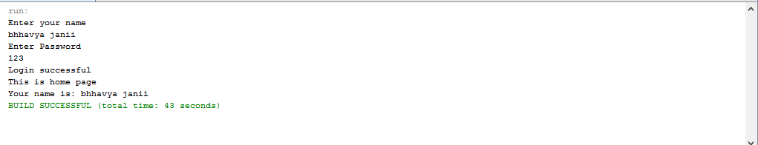
Non-GUI program on java
Login
Linking with the database
Outpass generation(automatic) by fetching records from the database

Slide 8
Integration of the program with GUI
GUI using Swings, a GUI widget toolkit
Provides following features
Drag & Drop
Automatic code generation of the GUI
Easy to integrate & Implement

Slide 9
Porting it on android
Run using an emulator (within Android SDK)
Create an AVD (Android virtual device)
Set specific parameters/requirements like software version, memory requirement.
Run from Net-beans

Slide 10
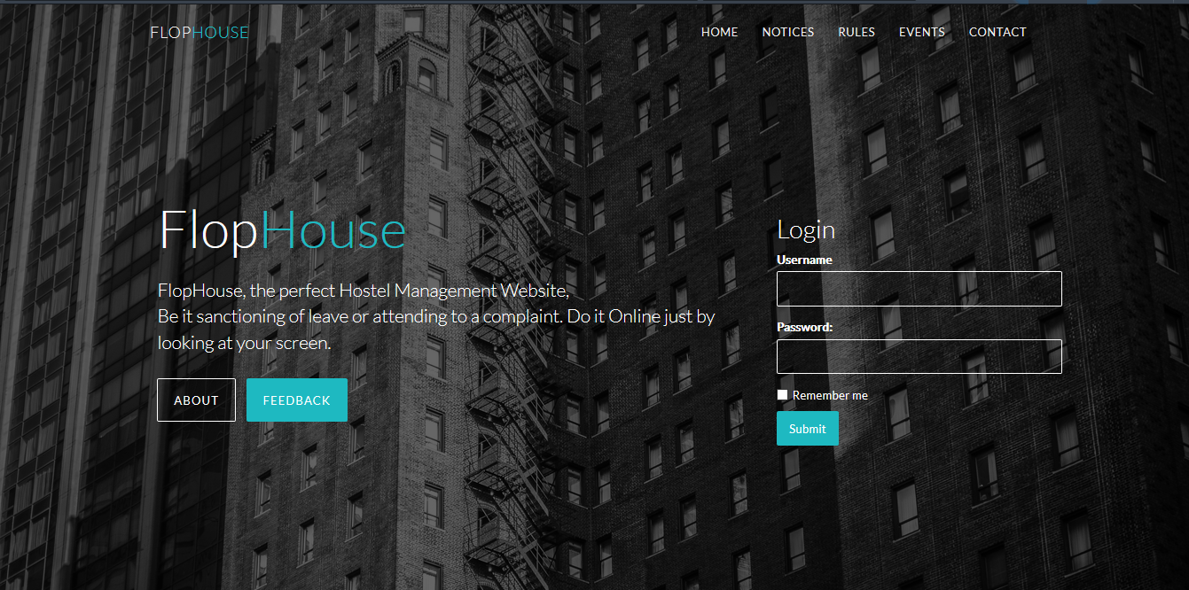
Website for Administrator

Slide 11
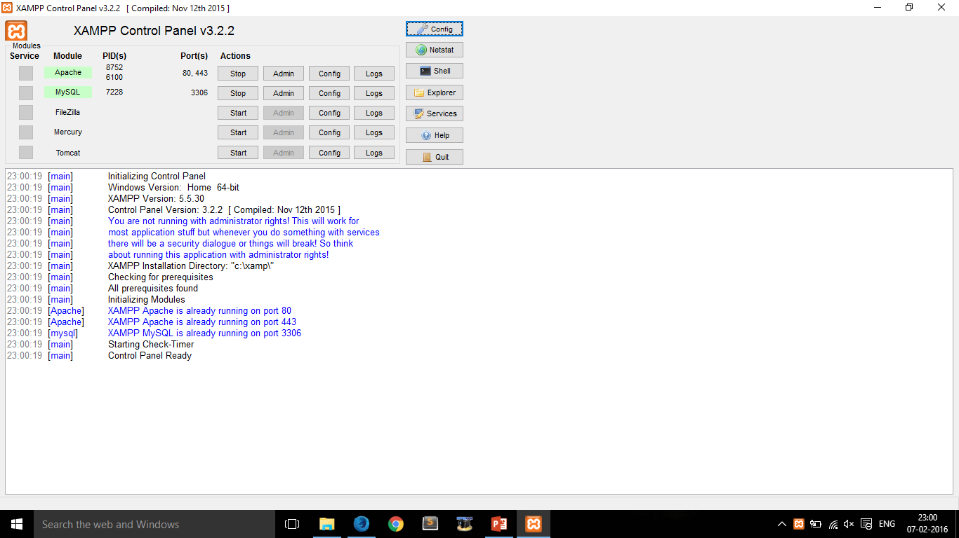
Upload webpage on a Local Webserver

Slide 12
Creating the Database
Database Name: flophouse
User Name: root
Password: n/a
Table names
Login = Students + Admin
Complaints
Out - Pass
Leave

Slide 13
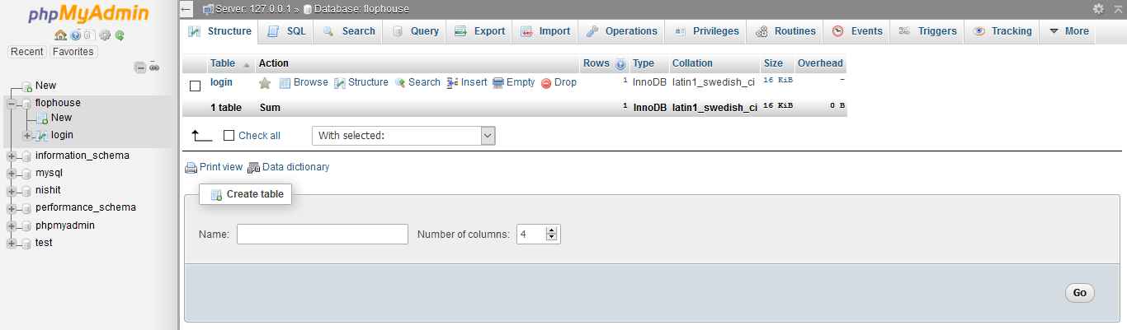
Putting the database on a server

Slide 14
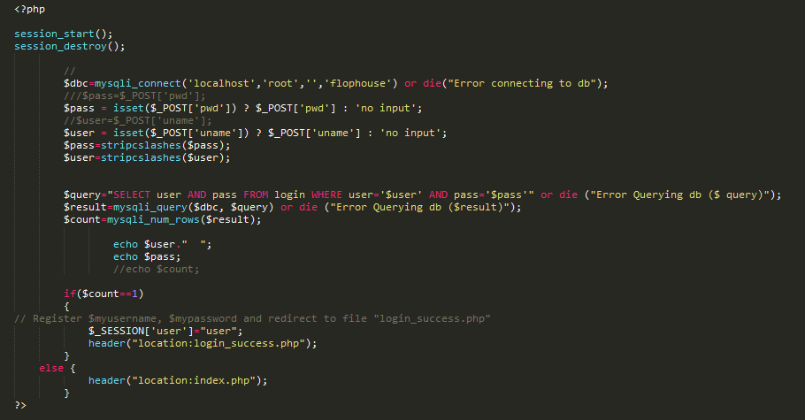
Integration of the app/website with the database

Slide 15
Summary
We have created the login module of both the website and the non-GUI java application.
Started designing the database schema.
Implemented the login table using MySQL service on XAMPP.
Working on the integration of the database with the Application and the website.

